Slide 1


Smart city
https://omrania.com/insights/smart-cities-need-culture-and-community-not-just-data/

Slide 2
INTRODUCTION
This document explores and presents our
Smart City project, a team effort to transform
urban living through innovative technology.
We're working together to redefine how cities
function by introducing smart solutions. ​

Slide 3
Key achievements
Energy Consumption
Fast mobility
Low Traffic jam
EMergency scenario

Slide 4
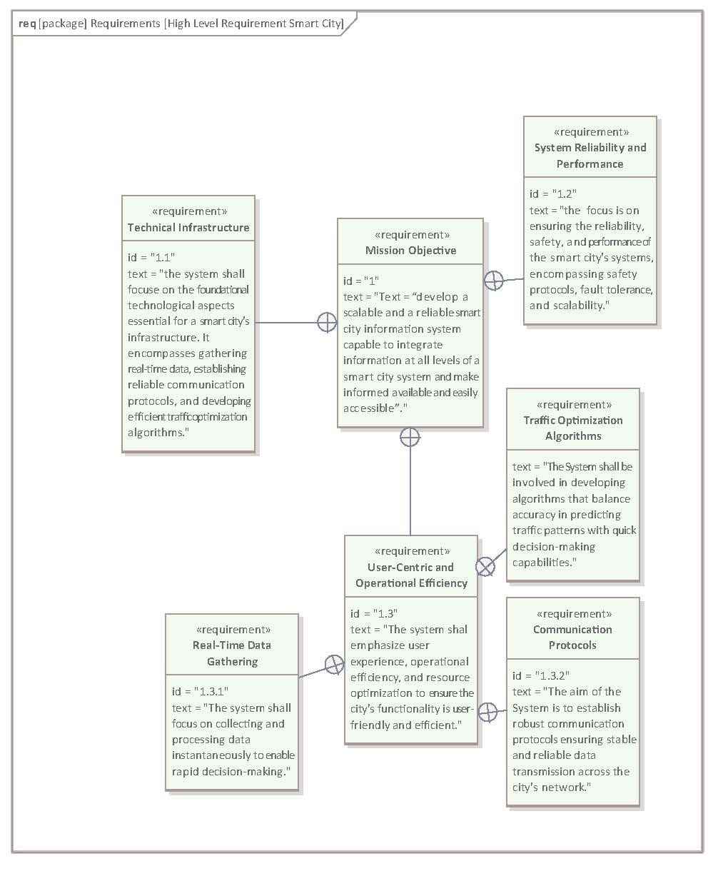

Slide 5
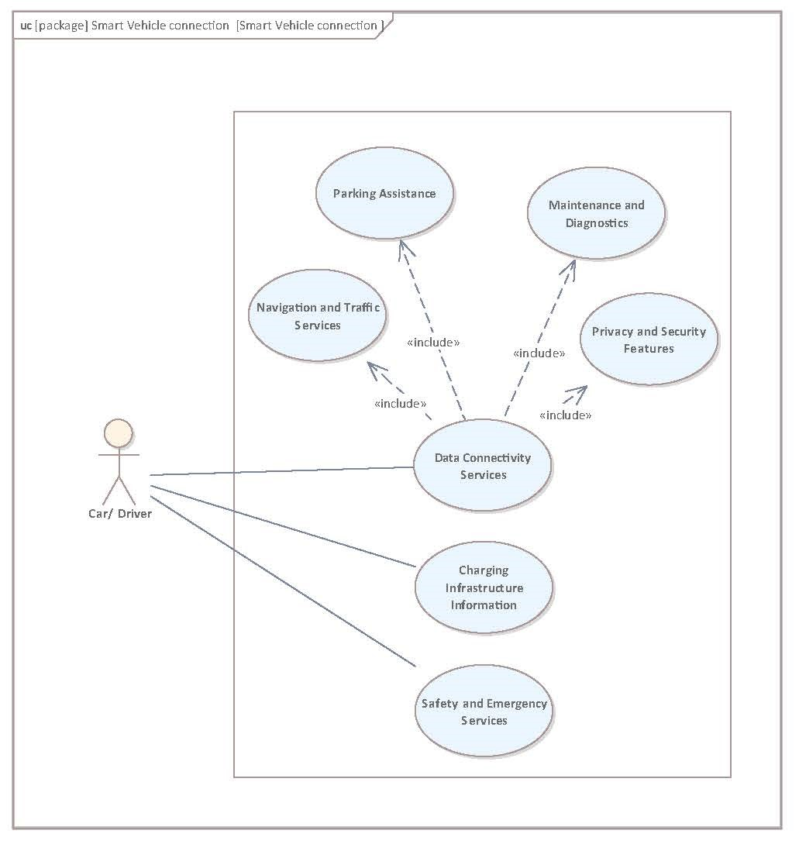
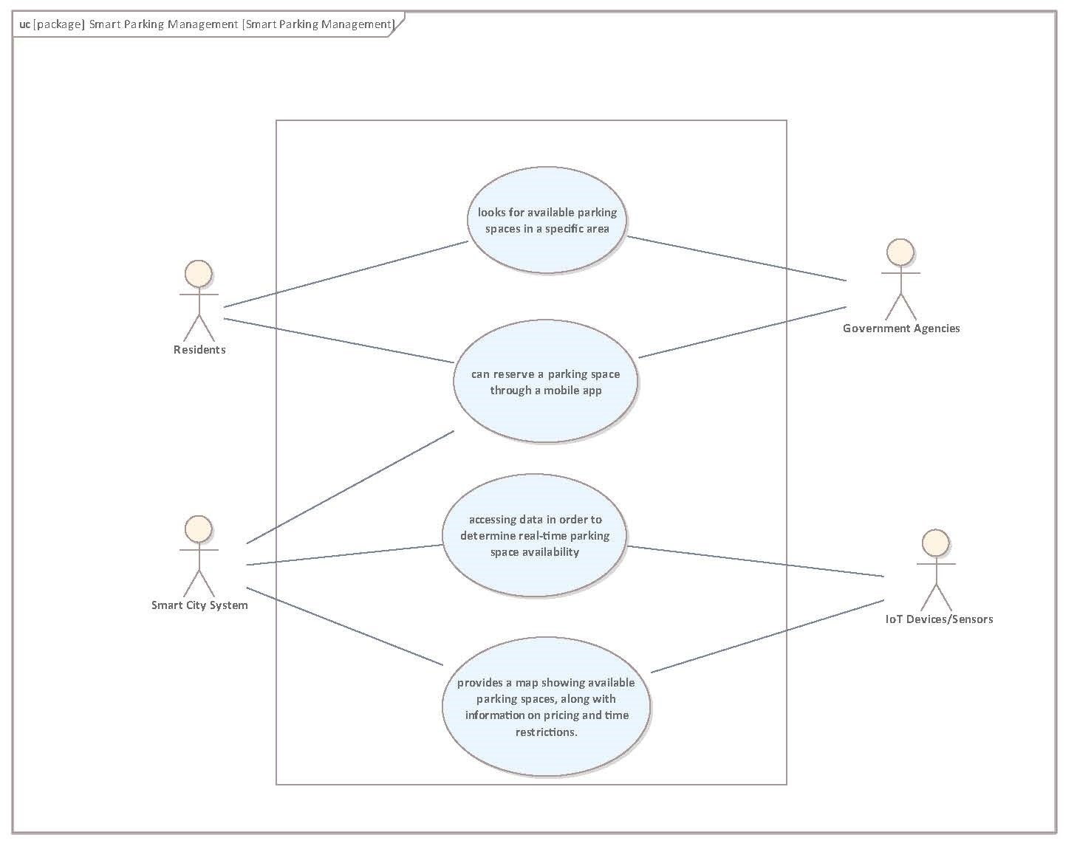

Slide 6
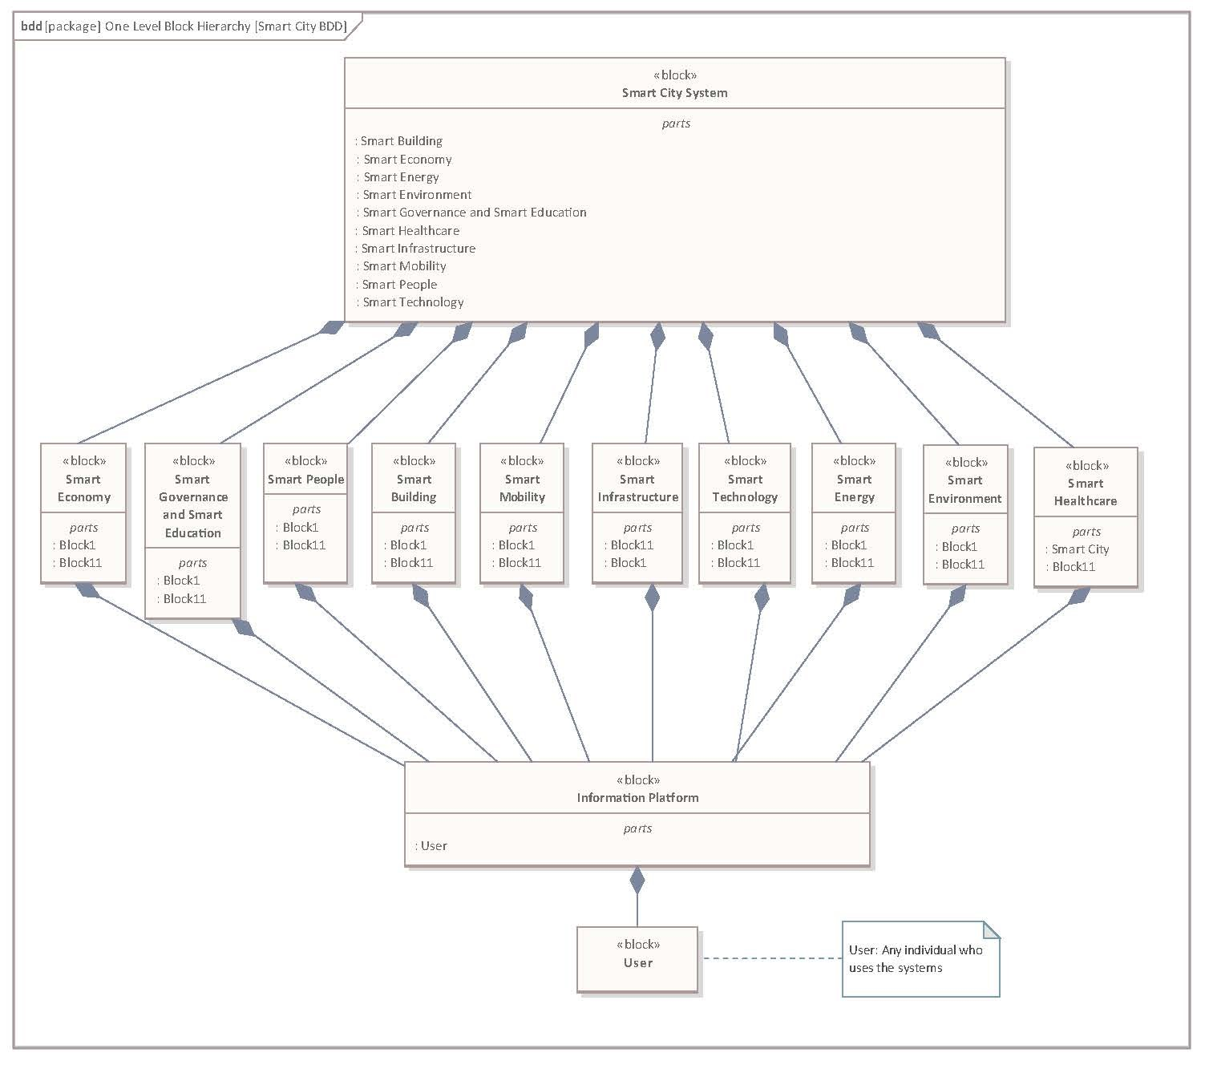

Slide 7
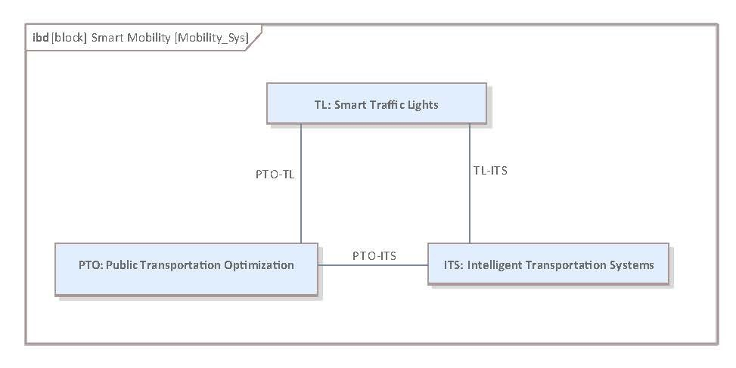

Slide 8
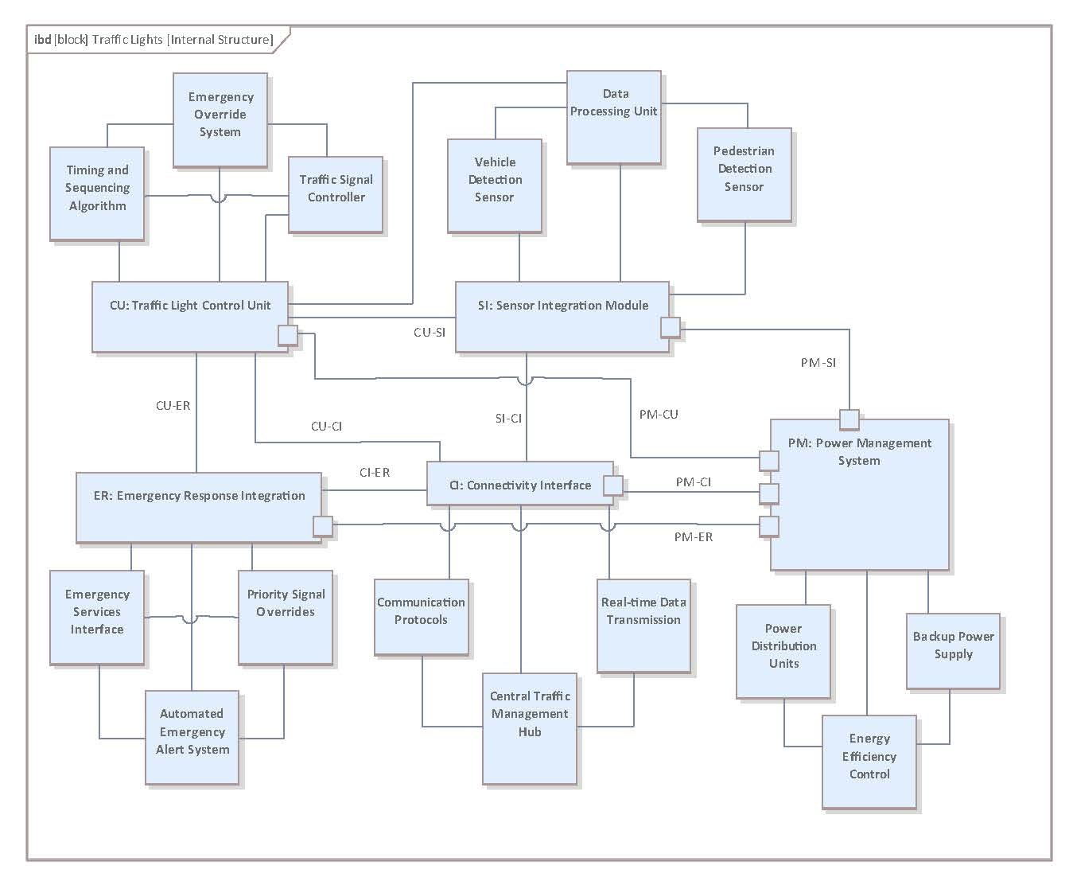

Slide 9
Activity Diagram

Slide 10
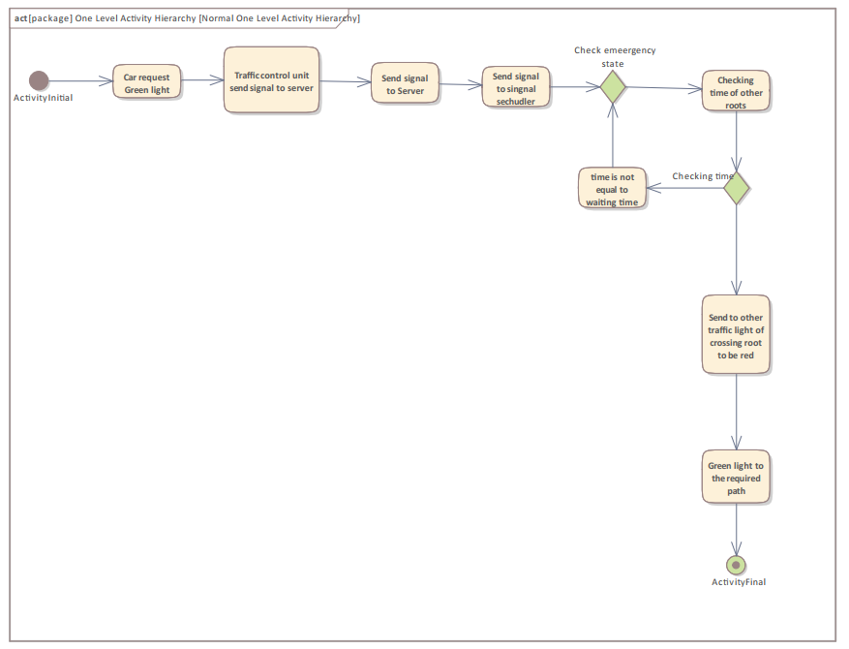
Normal case

Slide 11
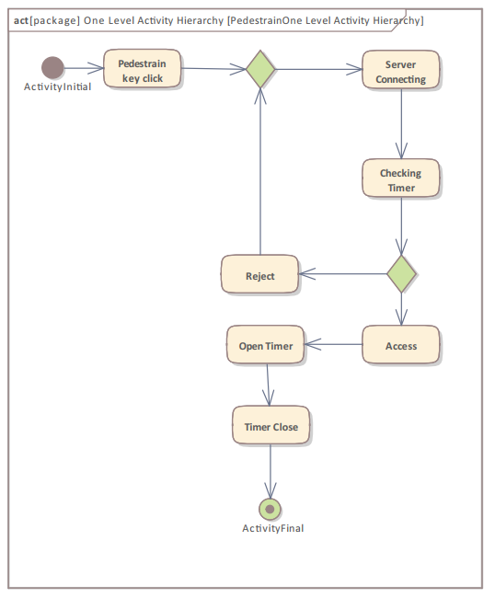
Pedestrian case

Slide 12
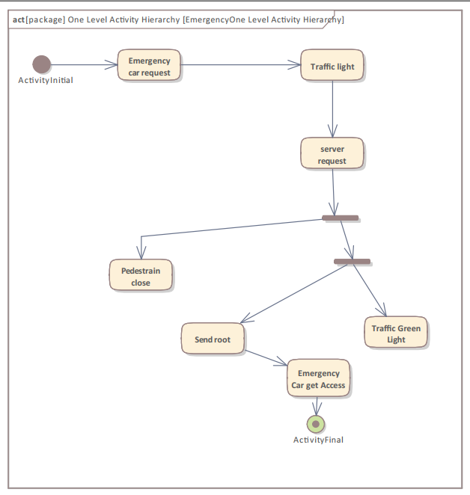
Emergency activity

Slide 13
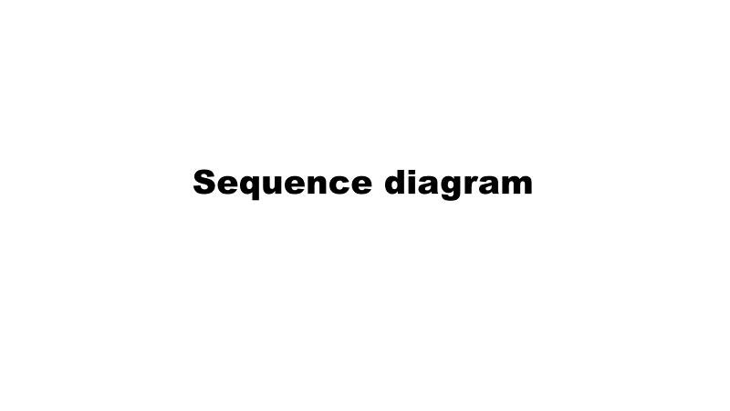

Slide 14
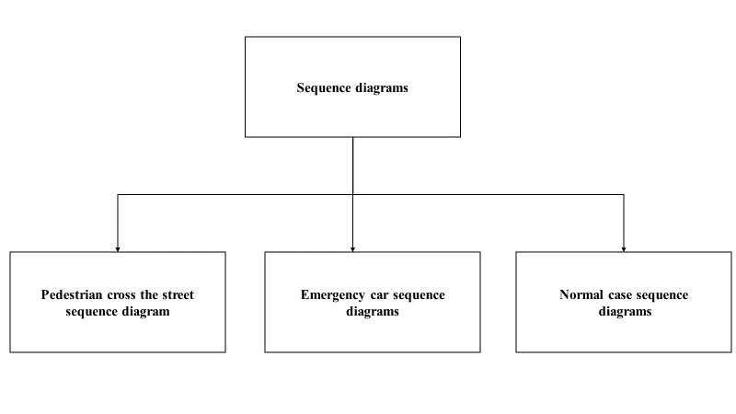

Slide 15
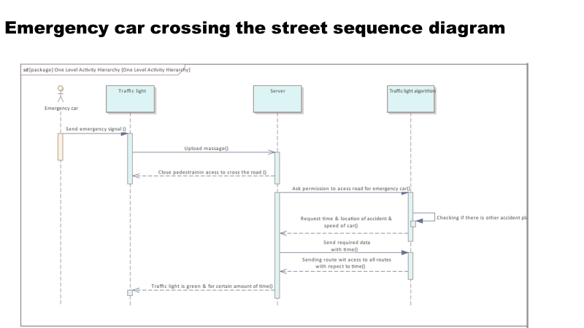

Slide 16
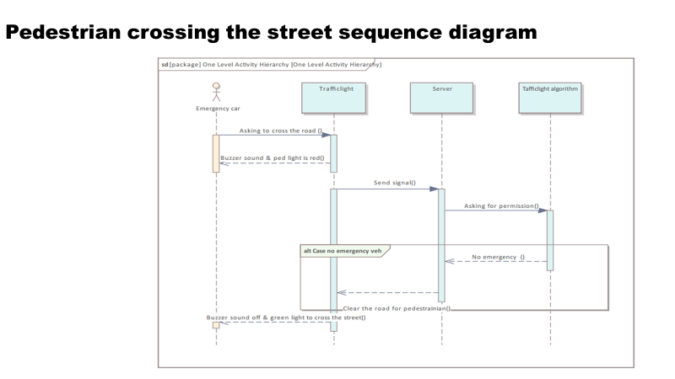

Slide 17
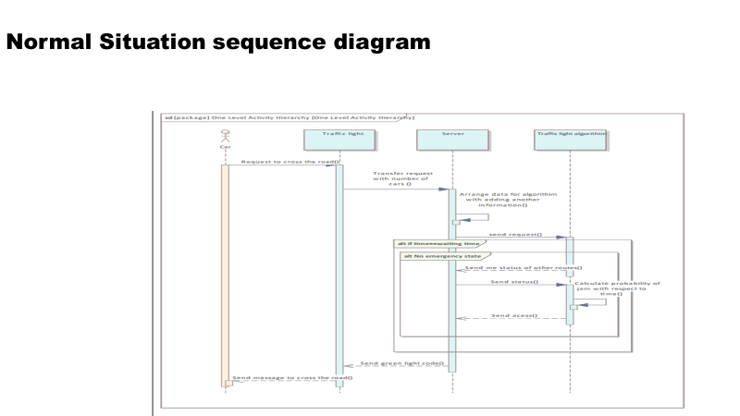

Slide 18
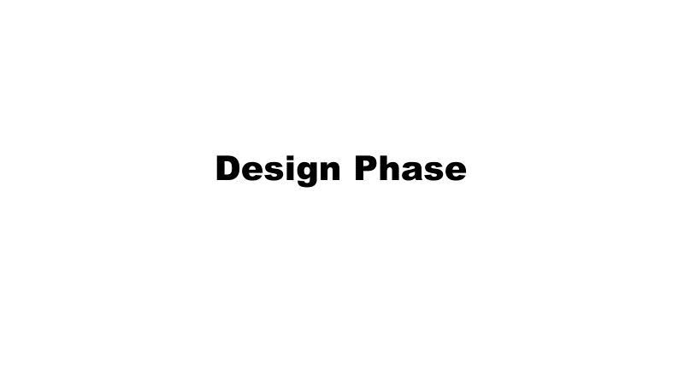

Slide 19
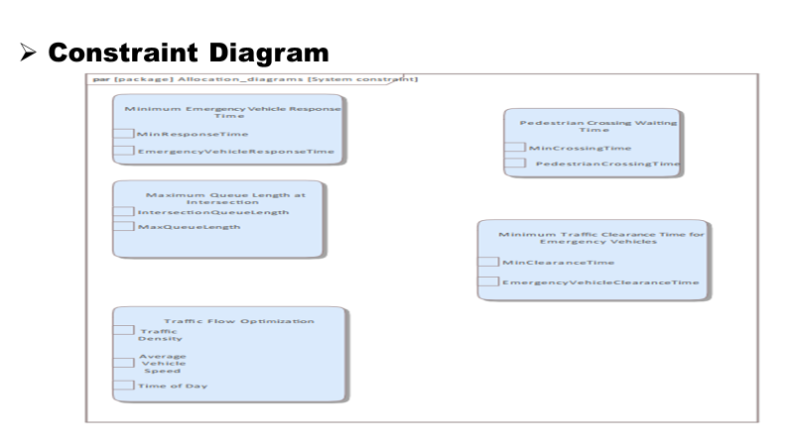

Slide 20
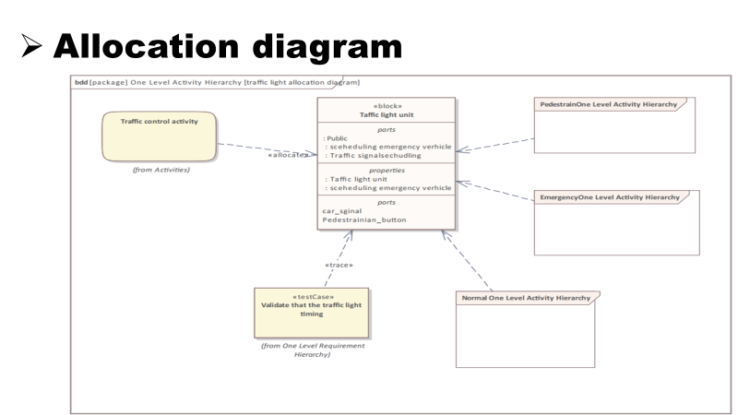

Slide 21
Implementation and Testing
Using two bluetooth modules
Using USART
Normal circuit
Unit Testing using google cpp framwork

Slide 22
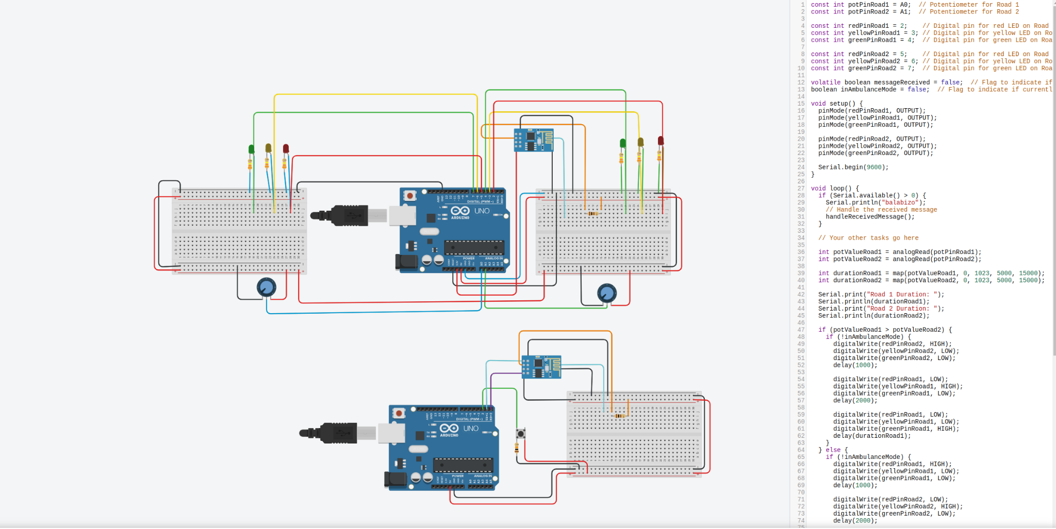
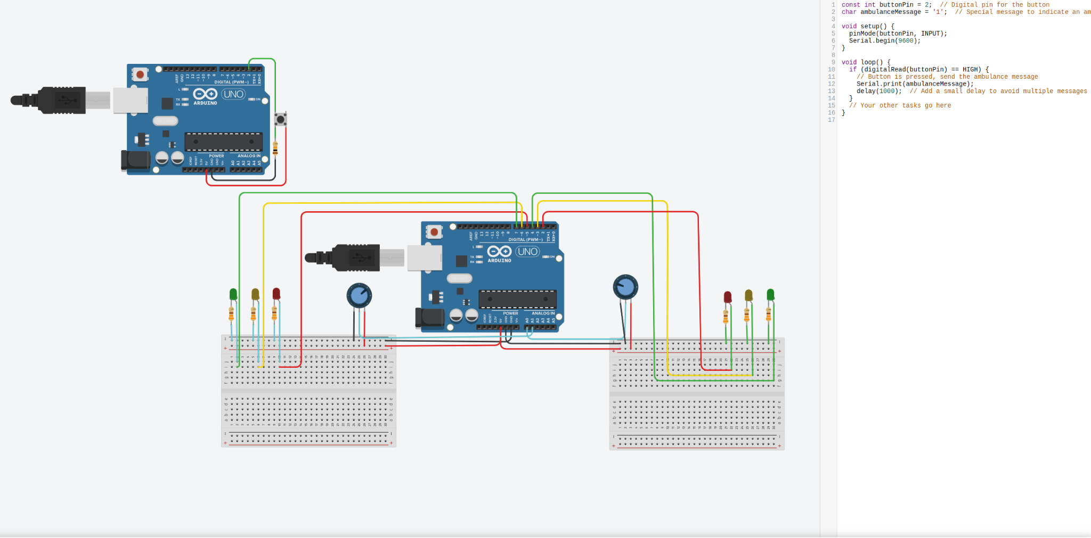
These are the two systems

Slide 23
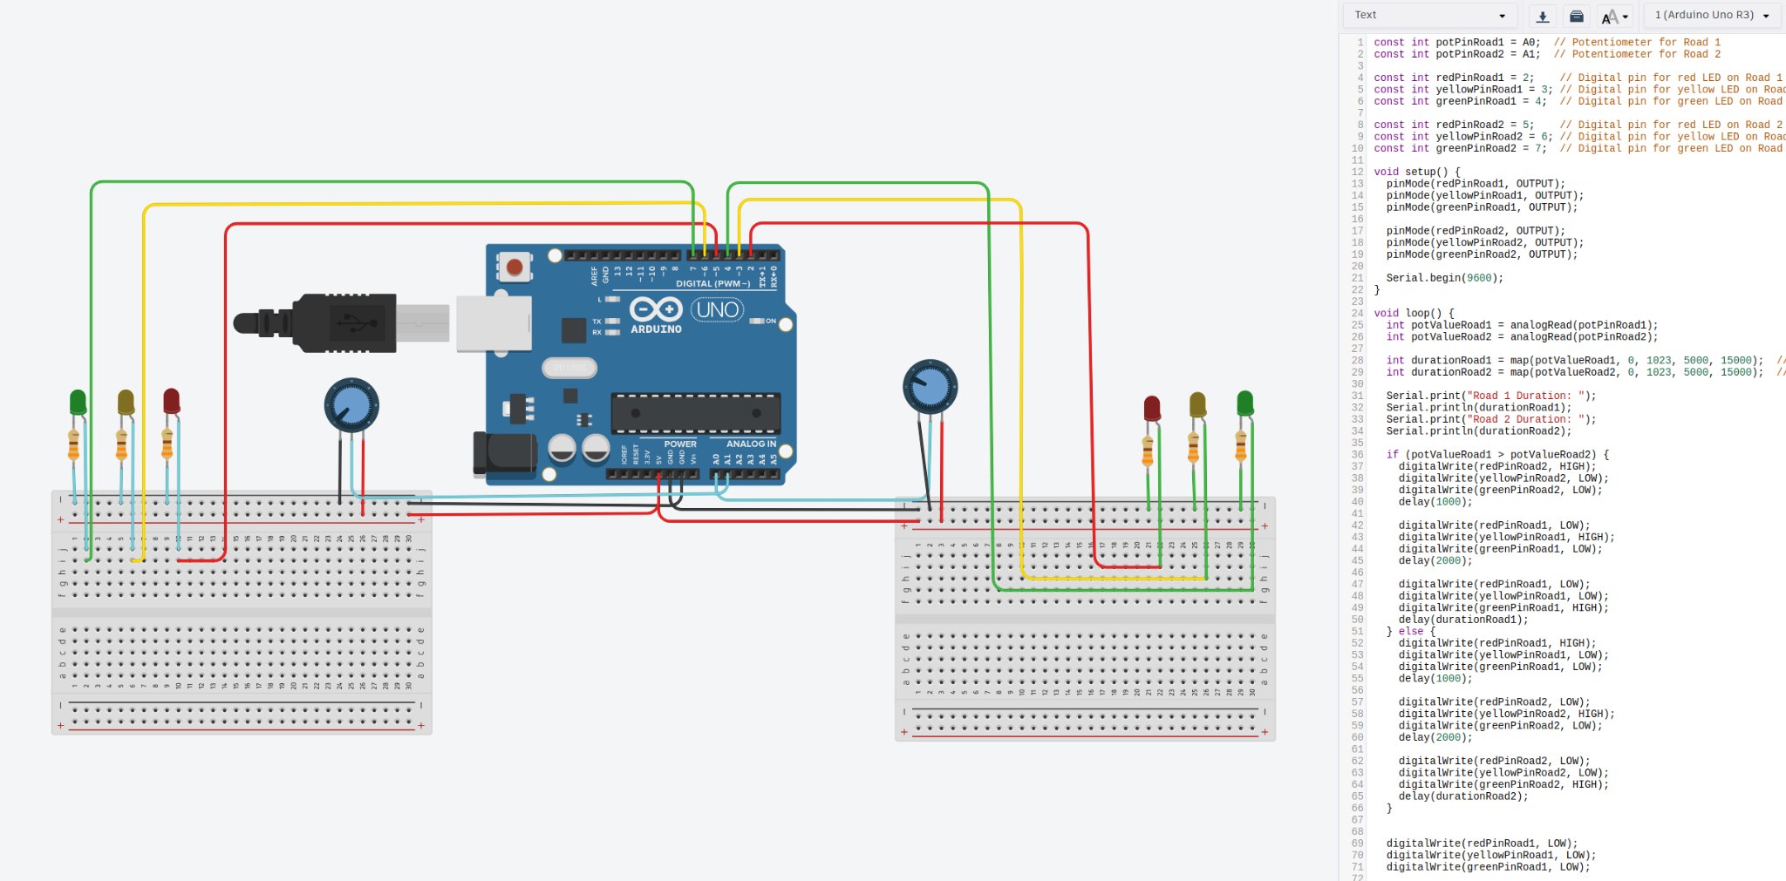
Final System

Slide 24
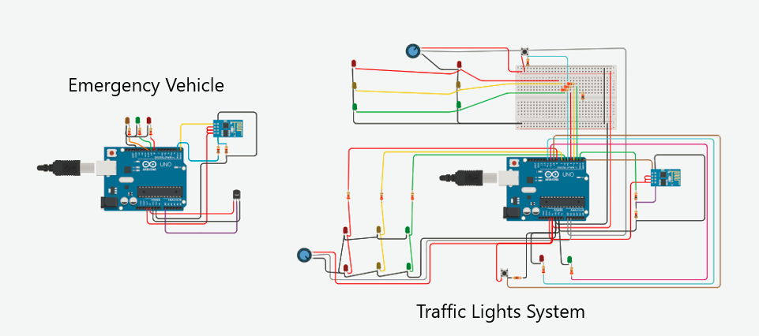

Slide 25
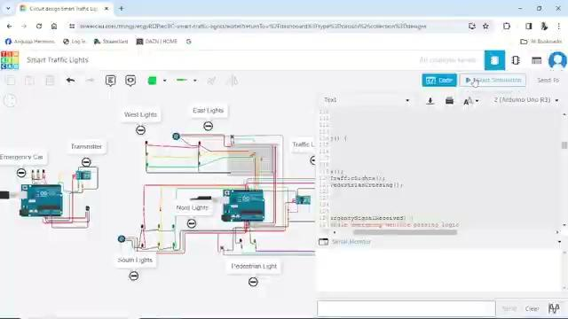

Slide 26
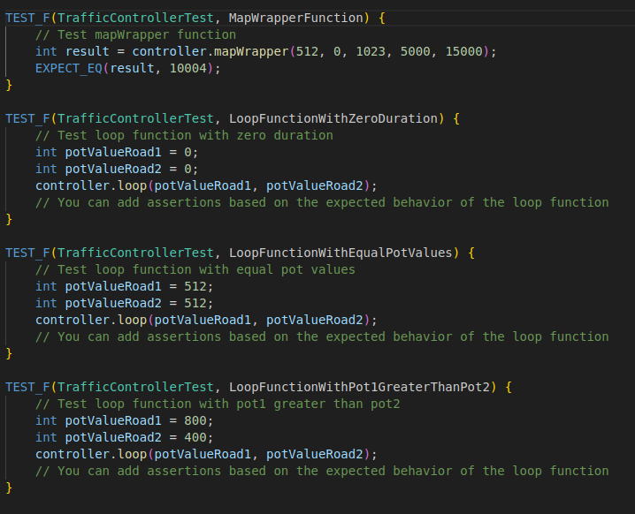
Unit test cases

Slide 27
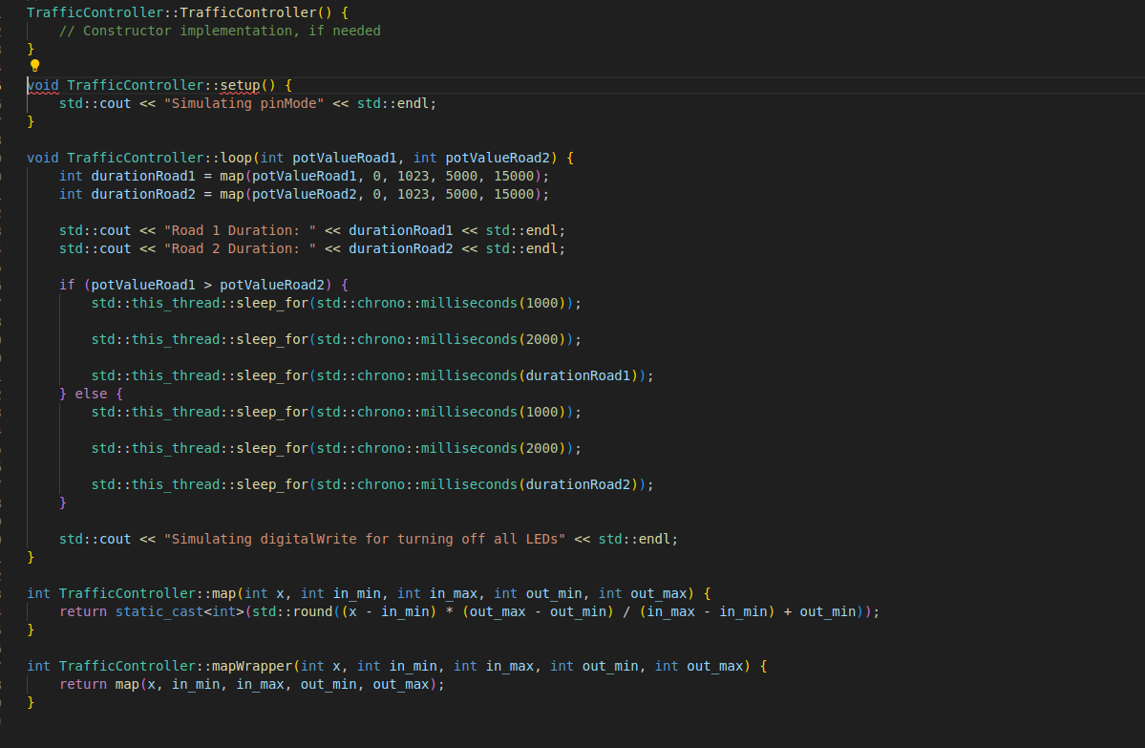

Slide 28
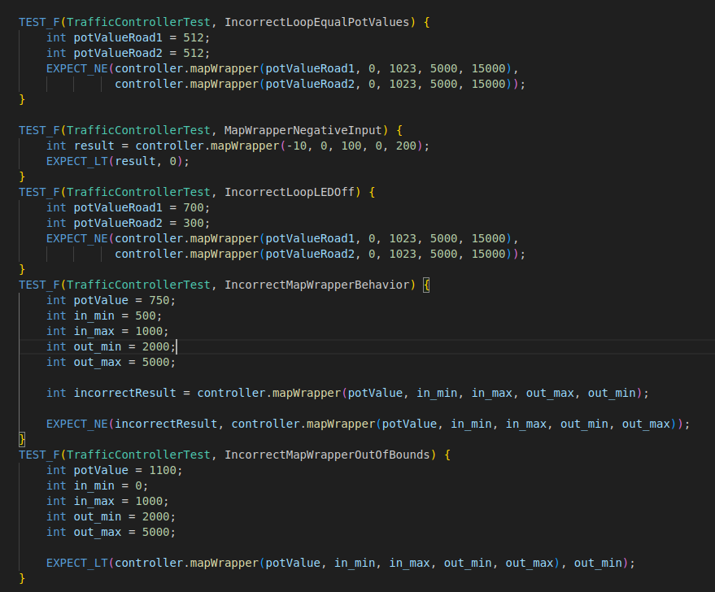
Defect Test cases:

Slide 29
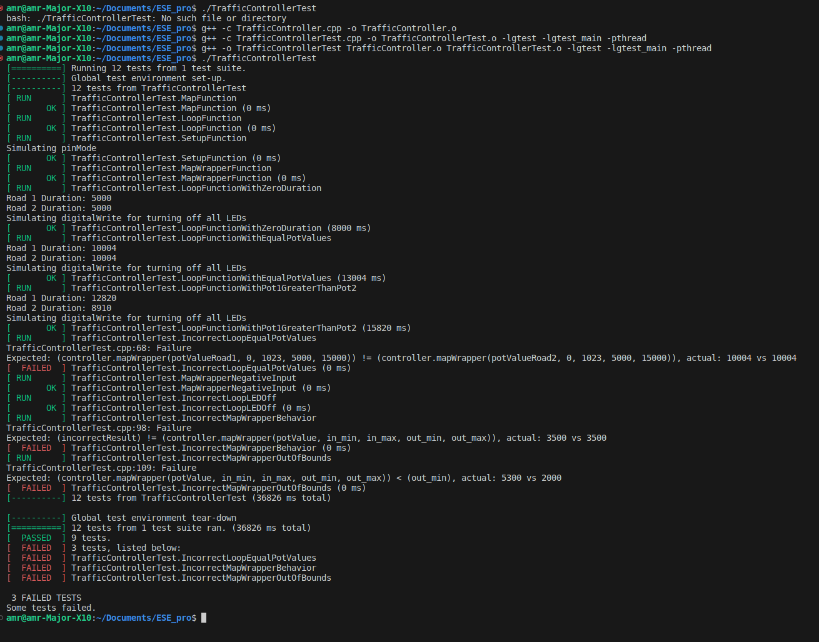

Slide 31
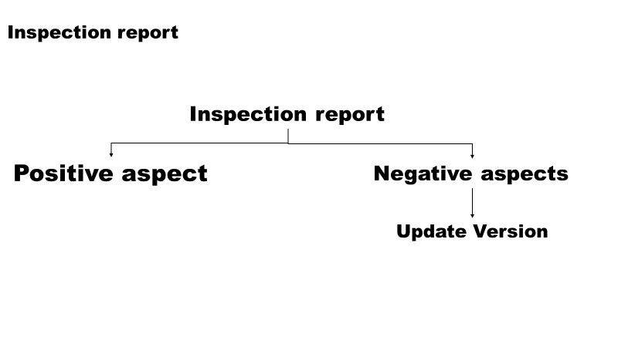

Slide 32
Scheduling
JavaFX
Tkinter
Python-RTS
Creating EDF and RMS
Analysis

Slide 33
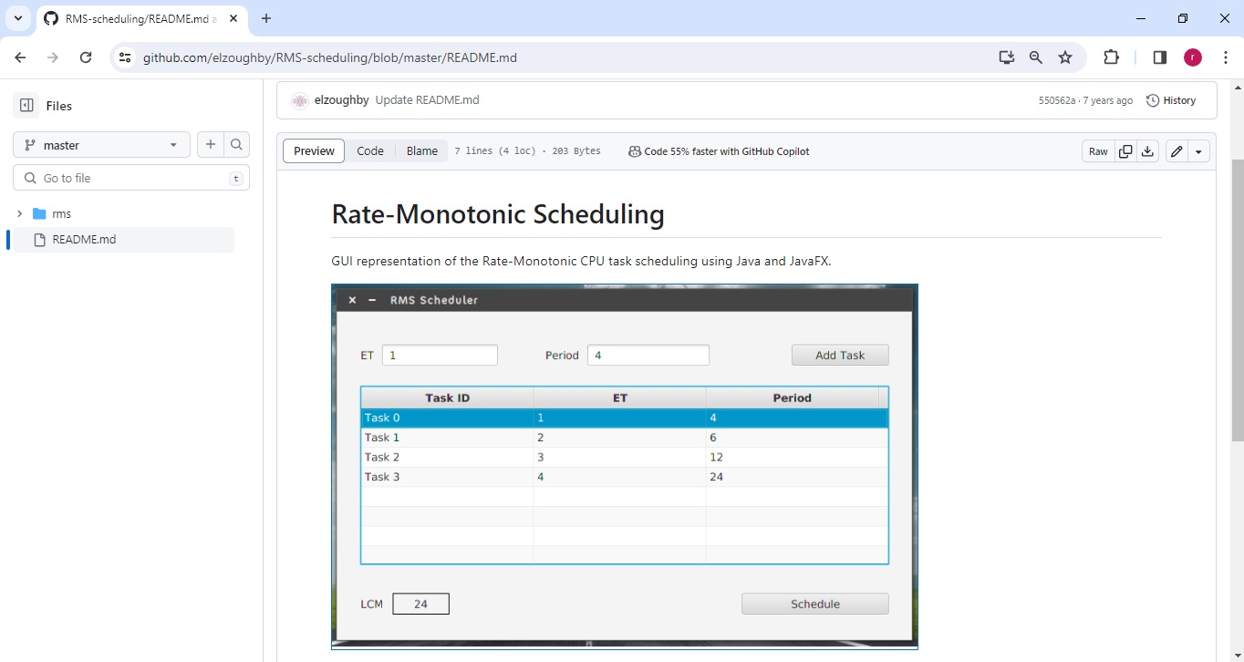
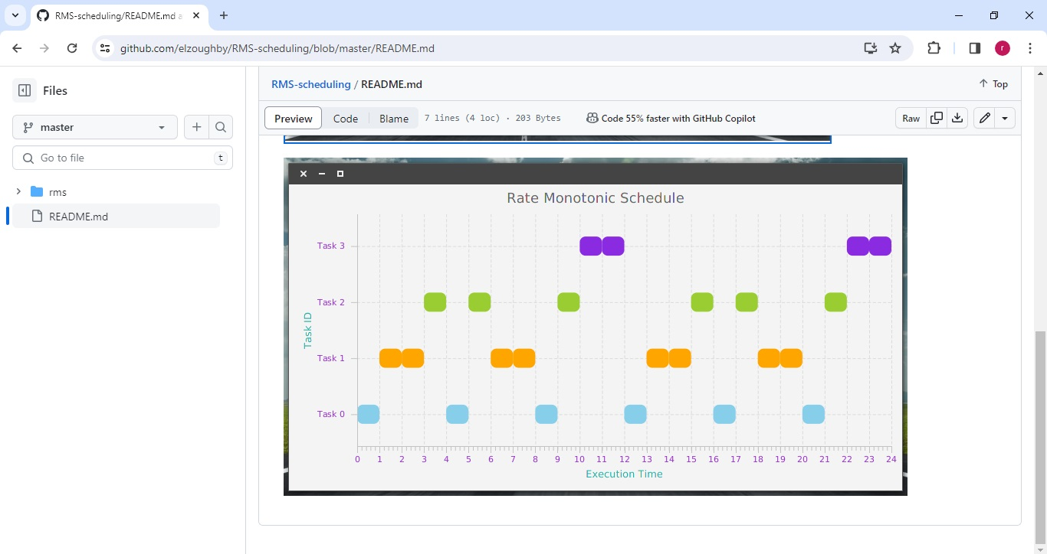

JavaFX
Notes:
We tried utilizing a code we found on github that uses a client application platform for desktop, mobile and embedded systems called JavaFX

Slide 34
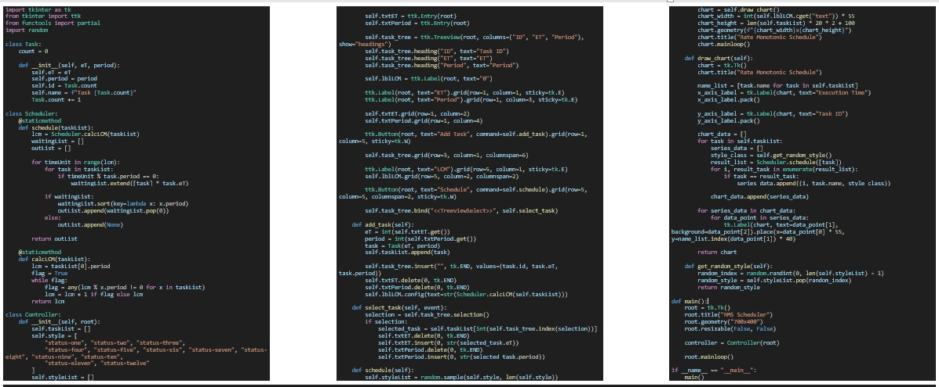
Python with Tkinter

Slide 35
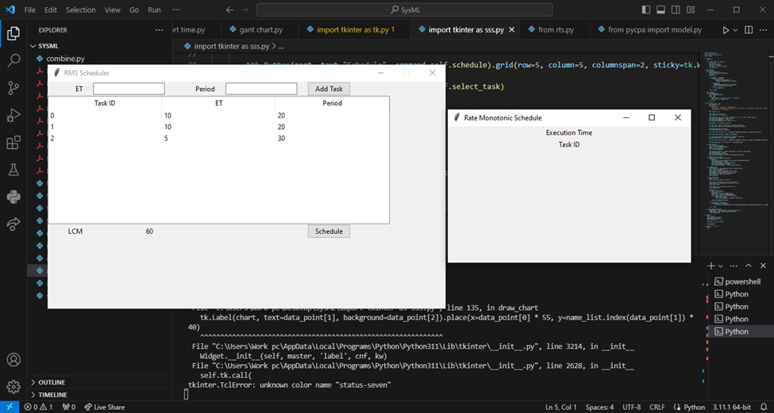
Python with Tkinter
Notes:
we ran into some issues and bugs, so I used the same concepts in python with the use of tkinter a Graphical User Interface toolkit. I got the real time system I desired but the results were not visualized as required.

Slide 36
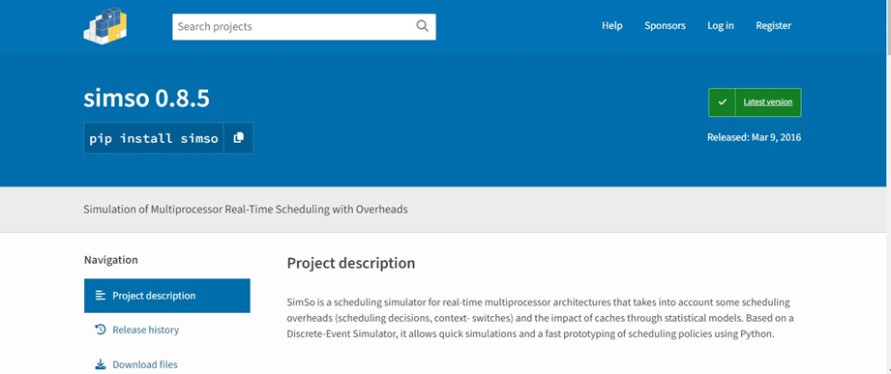
SIMSO
Notes:
the following approach was using a scheduling silulator for real time systems named simso but we encountered once again more errors so we had to switch gears once more

Slide 37
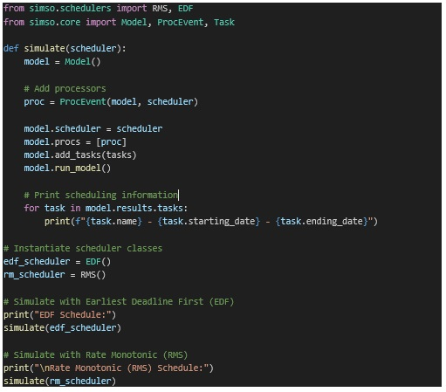
SIMSO

Slide 38
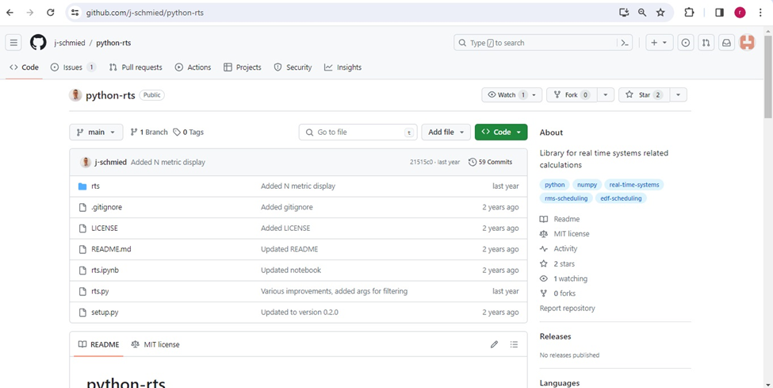
Python-RTS
Notes:
the following approach was using using a real-time systems library from GitHub called python-RTS, but it was still a work in progress, and not all features were there. I ran into some issues and bugs, even though I tried fixing them. The library had its limits and wasn't planned to get more updates. So, I explored other options, and found a different library that suited my project better. This experience shows my dedication to testing things out thoroughly and problem-solving to find the best tools for the job.

Slide 39
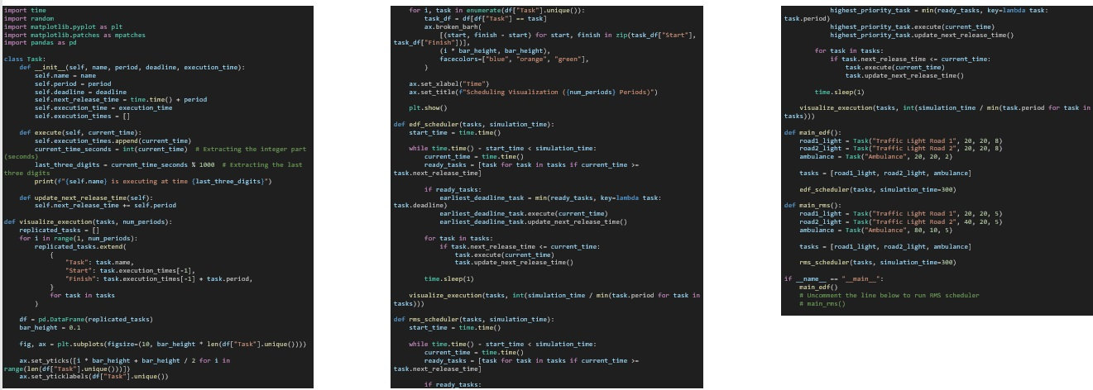
Python EDF
& RMS
Notes:
Those trials were all aiming at creating a real time system which will allow the system to be dynamic in order to test multiple variations with the ability to visualize the output. The final model only works with static values but it visualizes the output as desired with edf and rms.

Slide 40
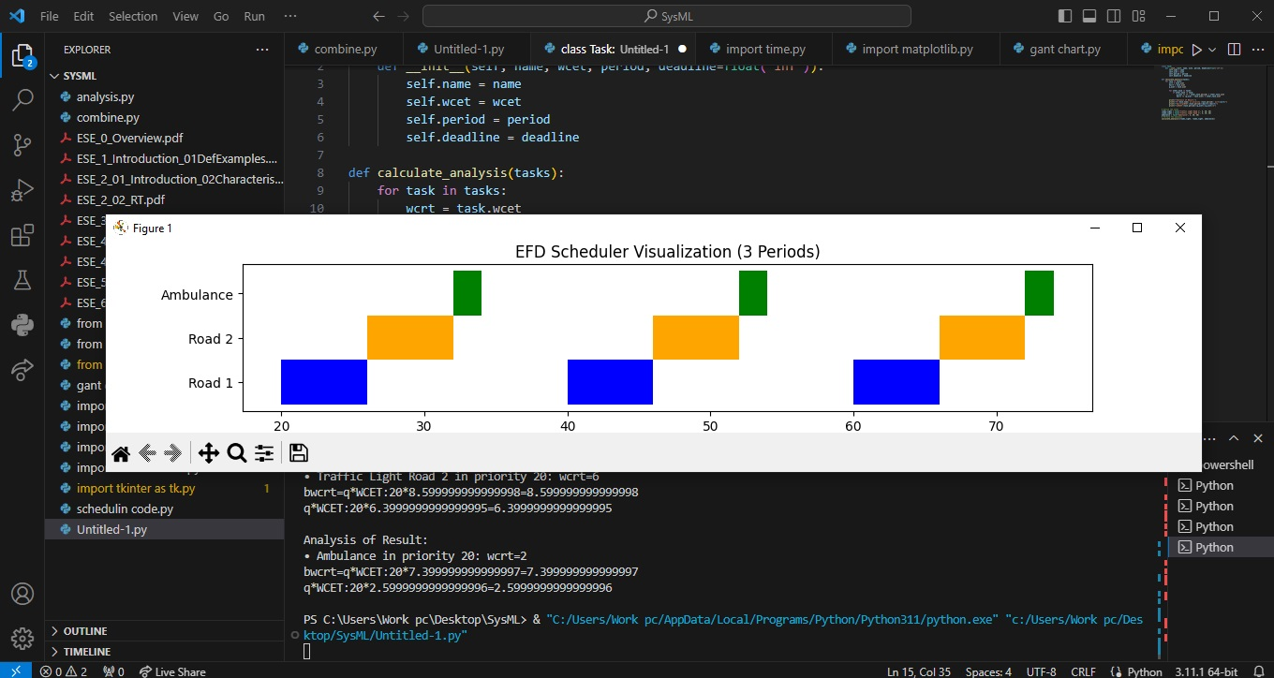
Python EDF
& RMS

Slide 41
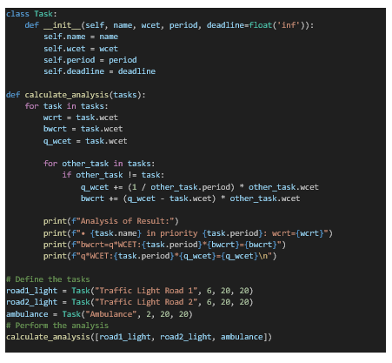
Python EDF
& RMS

Slide 42
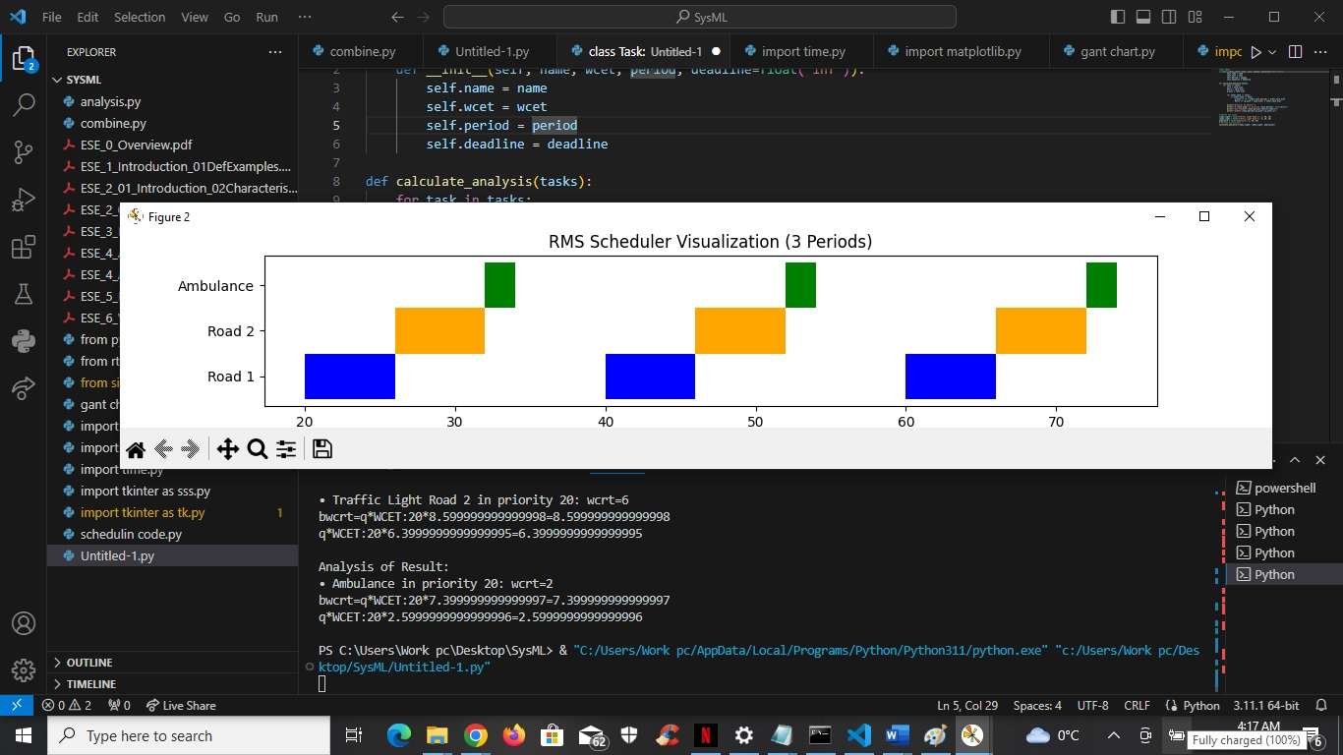
Python EDF
& RMS

Slide 43
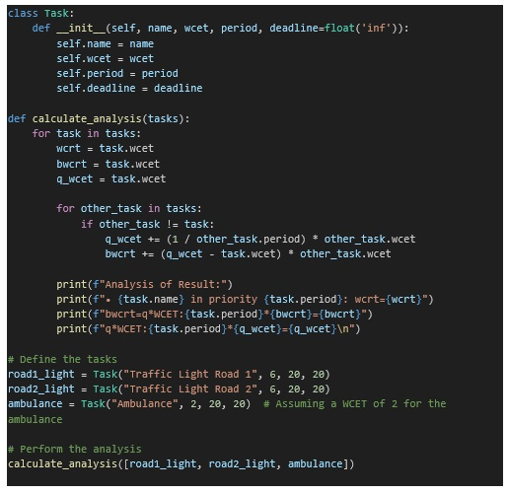
Python EDF
& RMS Analysis

Slide 44
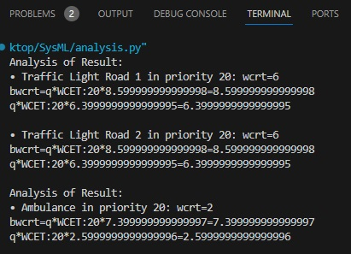
Python EDF
& RMS Analysis

Slide 45
Traffic Light Hazards with probabilities

Slide 46
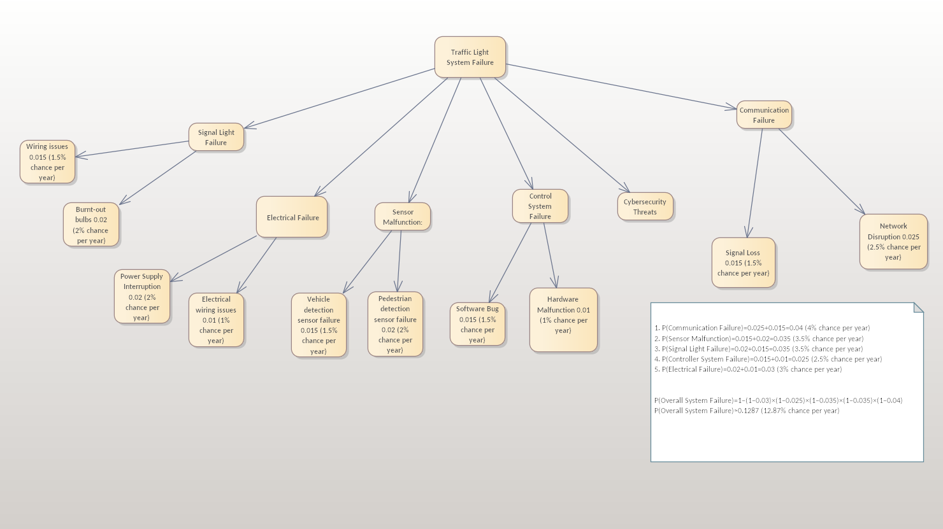

Slide 47
Hazard Handling at Design Level
superfluity: Backup power and communication systems.
Sensor Calibration: Regular maintenance and calibration.
Software Validation: Rigorous testing and validation.
Hardware Redundancy: Duplicate critical components.

Slide 48
Hazard Handling at Implementation Level
Regular Maintenance: Routine checks and maintenance.
Remote Monitoring: Systems for remote monitoring.
Security Measures: Cybersecurity protocols and firewalls.

Slide 49
Design and Development Process
We identified and refined at least 10 requirements, defined the context and use cases, and visualized the system's architecture with block diagrams and sequence diagrams.

Slide 50
Implementation and Testing
Our work extends to the implementation level, showcasing the mapping to prototype hardware, including tinkercad platform.
We've executed 5 unit tests, defined and executed 5 defect tests, and conducted 3 component/interface tests. Our implementation has followed a test-driven development approach, ensuring reliability and functionality.

Slide 51
Scheduling and Performance Analysis
Breakdown of requirements into scheduling, utilizing pyCPA for computation time analysis, and ensuring the schedulability of implemented components for optimal system performance.

Slide 52
Thank you

